Slide 1

Reinforcement Learning
AI

Slide 2
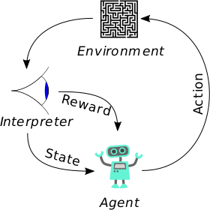
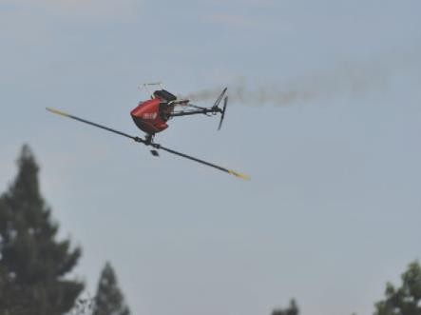
Reinforcement Learning Basic Concept
Reinforcement Learning is learning what to do – how to map situations to actions – so as to maximum a numerical reward.
Reinforcement Learning: An introduction Sutton & Barto
Rather than learning from explicit training data, or discovering patterns in static data, reinforcement learning discovers the best option (highest reward) from trial and error.
Inverse Reinforcement Learning
Learn reward function by observing an expert
“Apprenticeship learningapprenticeship learning“
E.g. Abbeel et al. Autonomous Helicopter Aerobatics through Apprenticeship Learning

Slide 3
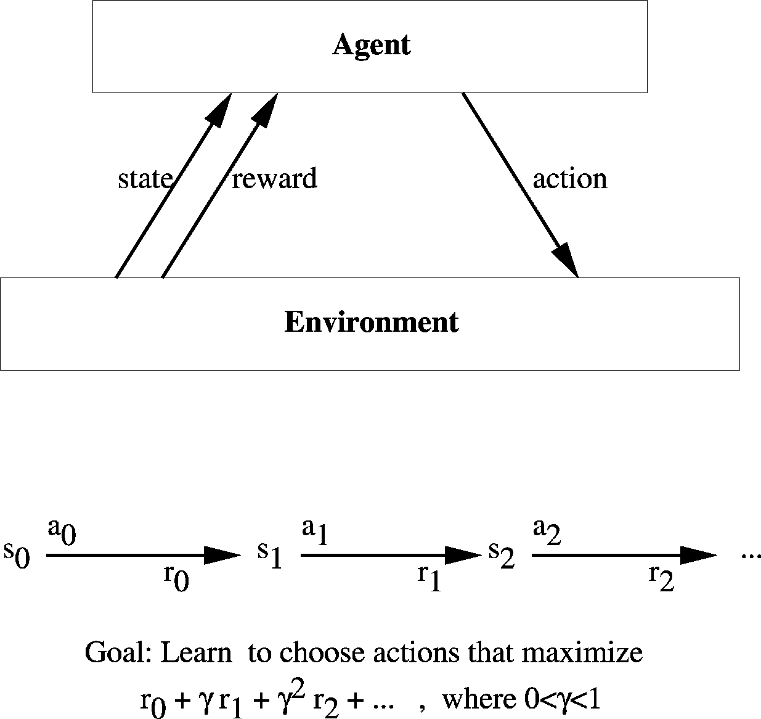
A Reinforcement Learning Problem
The environment
The reinforcement function r(s,a)
Pure delay reward and avoidance problems
Minimum time to goal
Games
The value function V(s)
Policy π: S → A
Value V ^{π}(s) := Σ_{i} γ^{i} r_{t+i}
Find the optimal policy π∗ that maximizes
V ^{π∗}(s) for all states s.

Slide 4
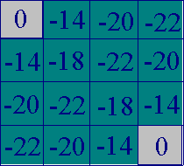
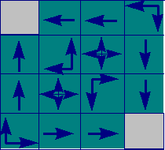
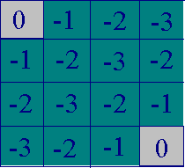
RL Value Function - Example
A minimum time to goal world
Value function | Optimal policy | Optimal value
for random |  | function
movement

Slide 5
Markov Decision Processes
Assume:
finite set of states S, finite set of actions A
at each discrete time agent observes state s_{t} ∈S and chooses action a_{t} ∈A
then receives immediate reward r_{t}
and state changes to s_{t+1}
Markov assumption: s_{t+1} = δ(s_{t},a_{t}) and r_{t} = r(s_{t},a_{t})
i.e. r_{t} and s_{t+1} depend only on current state and action
functions δ and r may be non-deterministic
functions δ and r not necessarily known to the agent

Slide 6
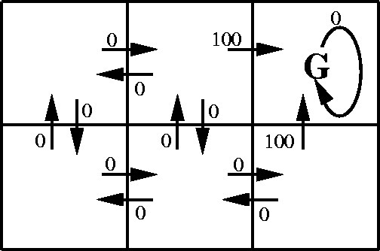
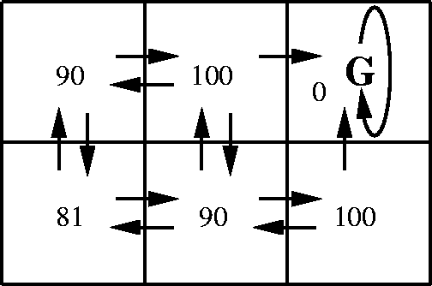
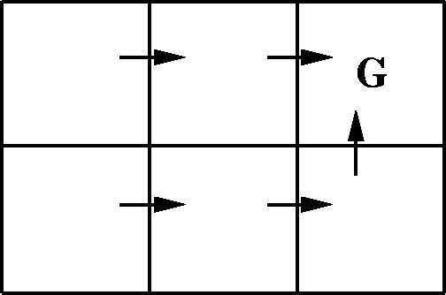
MDP Example
r(s,a)
V*(s)
An optimal policy

Slide 7
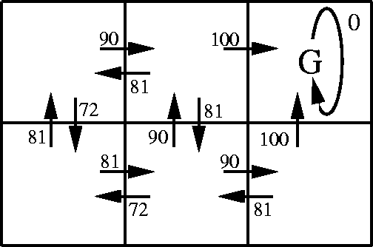
The Q-Function
Optimal policy:
π*(s) = argmax_{a}[r (s,a) + γV *(δ(s,a))]
Doesn't work if we don't know r and δ.
r(s,a)
The Q-function:
Q (s,a) := r (s,a) + γV *(δ(s,a))
π*(s) = argmax_{a}Q (s,a)
Q(s,a)

Slide 8
The Q-Function
Note Q and V* closely related:
V *(s) = max_{a'} Q (s,a' )
Therefore Q can be written as:
Q (s_{t} ,a_{t}) := r (s_{t} ,a_{t}) + γV *(δ(s_{t} ,a_{t})) =
r (s_{t} ,a_{t}) + γ max_{a'} Q (s_{t+1} ,a' )
If Q^ denote the current approximation of Q then it can be updated by:
Q^(s,a) := r + γ max_{a'} Q^(s',a' )

Slide 9
Q-Learning for Deterministic Worlds
For each s, a initialize table entry Q^(s,a) := 0. Observe current state s.
Do forever:
Select an action a and execute it
Receive immediate reward r
Observe the new state s'
Update the table entry for Q^(s,a): Q^(s,a) := r + γ max_{a'} Q^(s',a' )
s := s'

Slide 10
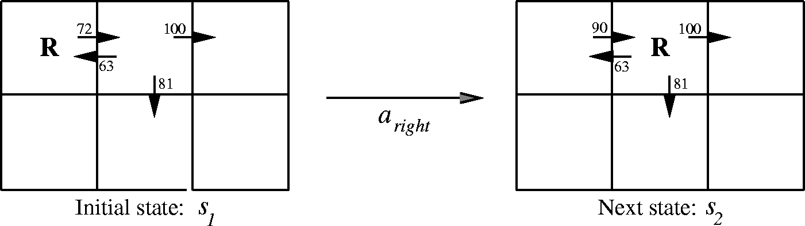
Q-Learning Example
Q ^(s₁ ,a_{right}) := r + γ max_{a'} Q ^(s₂ ,a' )
:= 0 + 0.9 max{63, 81, 100}
:= 90

Slide 11
Q-Learning Continued
Exploration
Selecting the best action
Probabilistic choice
Improving convergence
Update sequences
Remember old state-action transitions and their immediate reward
Non-deterministic MDPs
Temporal Difference Learning

Slide 12
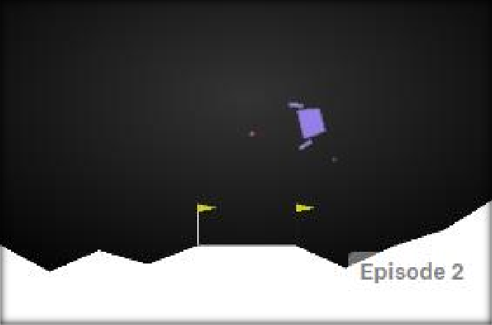
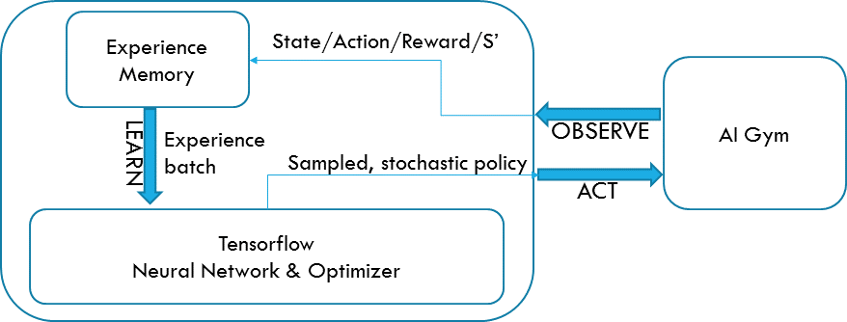
Reinforcement Learning – Neural Networks as Function Approximators
To tackle a high-dimensional state space or continous states we can use a neural network as function approximator
Lunar Lander experiment
8 continous/discrete states
XY-Pos, XY-Vel, Rot, Rot-rate, Leg1/Leg2 ground contact
4 discrete actions
Left thrust
Right thrust
Main engine thrust
NOP
Rewards
Move from top to bottom of the screen (+ ~100-140)
Land between the posts (+100)
Put legs on ground (+10 per leg)
Penalties
Using main engine thrust (-0.3 per frame)
Crashing (-100)
Solved using Stochastic Policy Gradients

Slide 13
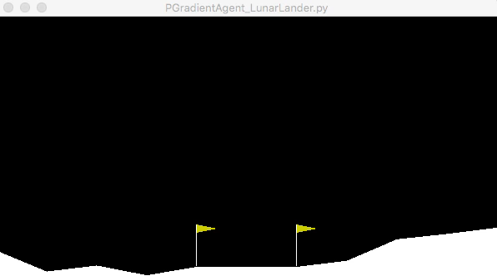
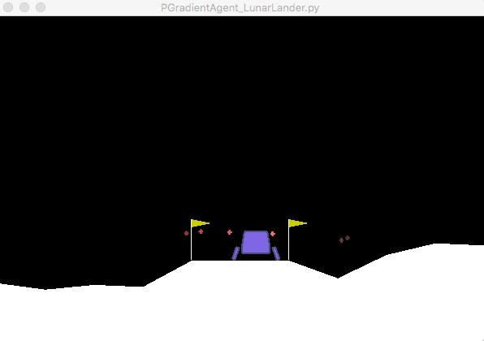
Reinforcement Learning Neural Networks as Function Approximators

